Slide 1
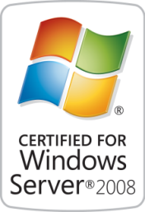
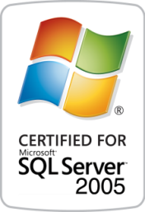
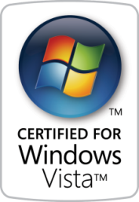

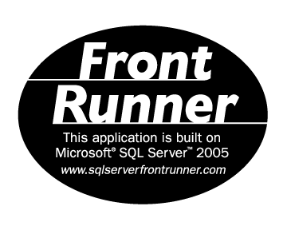


Solutions for Performance Driven Companies
Aras Innovator
enterprise PLM solution suite
Notes:
1

Slide 2
Agenda
Aras Company Overview
PLM ‘out-of-the-box’ Solutions
Aras Model-Based Technology (configurability)
Enterprise Open Source Business Model
Demo

Slide 3
PLM Market The Real-Word Problems with PLM
PLM Doesn’t Deliver Business Requirements
Introducing new Products is not just a CAD Management Problem
Expensive Change Management
Not Flexible Enough to Automate Company-Specific Processes
Impossible Upgrades to New Versions
Expensive & Sometimes even Impossible to Upgrade PLM Systems
Integration and Support for Cross Functional Processes
Lots of People need Access, not just Engineering
Product Management, Quality, Operations, Sourcing, Procurement
Suppliers, Outsourced Manufacturing, Outside Design & Engineering
High Total Cost of Ownership
source: www.plmtwine.com June 1,2010

Slide 4
Why is Aras the Fastest Growing PLM Software?
Aras Technology: Model-Based SOA Framework
Simplifies PLM – most other PLM installations never get to production
Broadens PLM – PLM was too CAD focused, while companies need project management, quality, manufacturing, supply chain, and tooling
Easier to Configure - Modeling is a vastly simpler than programming and every company needs a custom PLM environment
Easiest to Upgrade - cost of upgrades is included in a fixed price subscription
Aras Business Model: Enterprise Open Source
Because large up-front software purchases skew the risk sharing and costs
Improves the relationship between customer and software vendor
Leverages the value of a PLM Community for best practices exchanges
2010: 700 Installations / Month

Slide 5
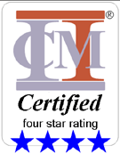

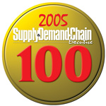
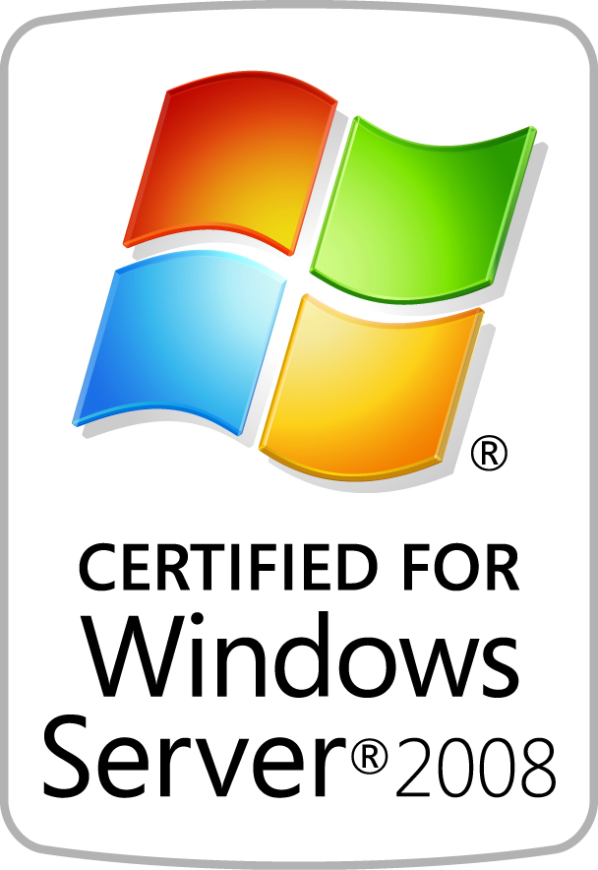
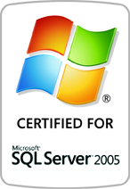
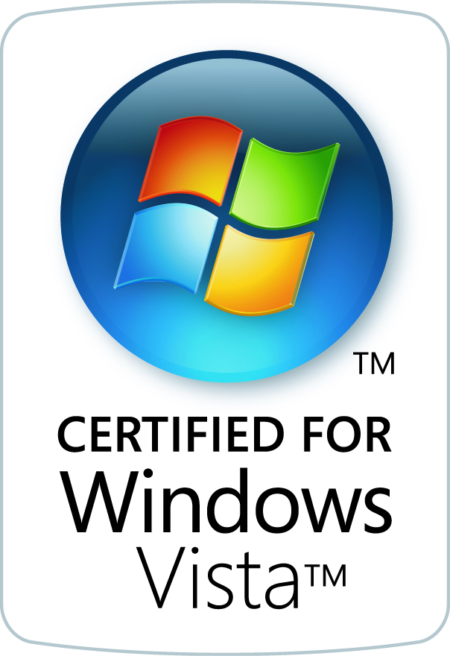



Aras Overview
Company: 11 years: Boston-Based, Global Organization
Business: Enterprise Open Source PLM Software
Program, Product and Project Management
Quality Compliance & Risk Management
Configuration & Change Management
Workflow / Enterprise BPM
PDM CAD Management
APQP
Quality Systems
Product: Aras Innovator ®
Technology: Advanced Model-Based SOA
Certifications: “Certified for” Entire Microsoft Platform

Slide 6




















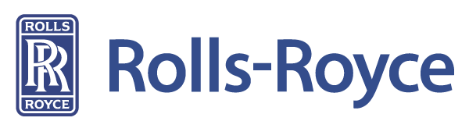








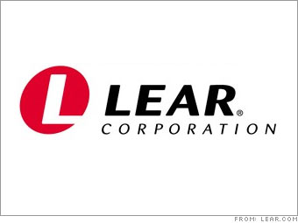























Aras Customers and 700+ world-wide installations / month
Slide 6

Slide 7

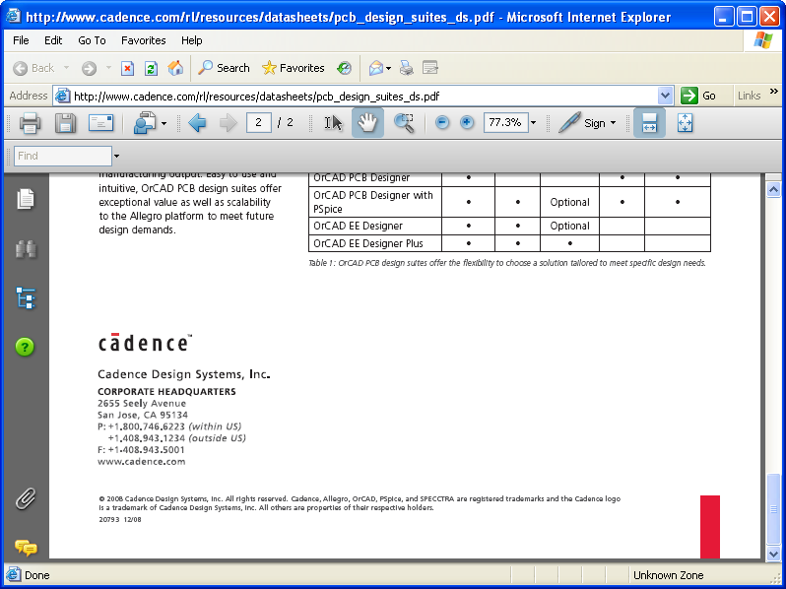





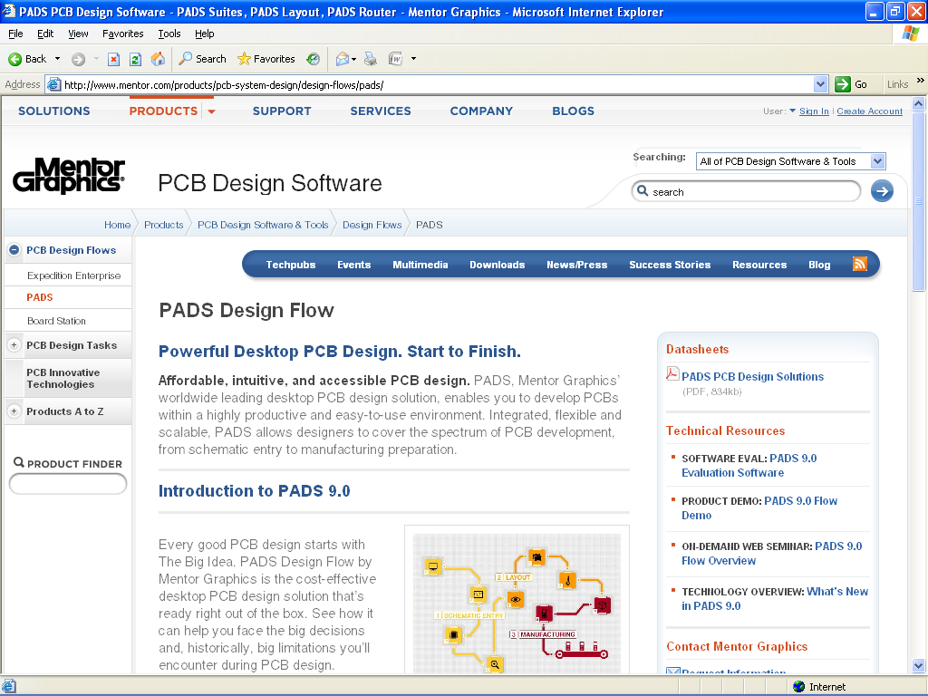

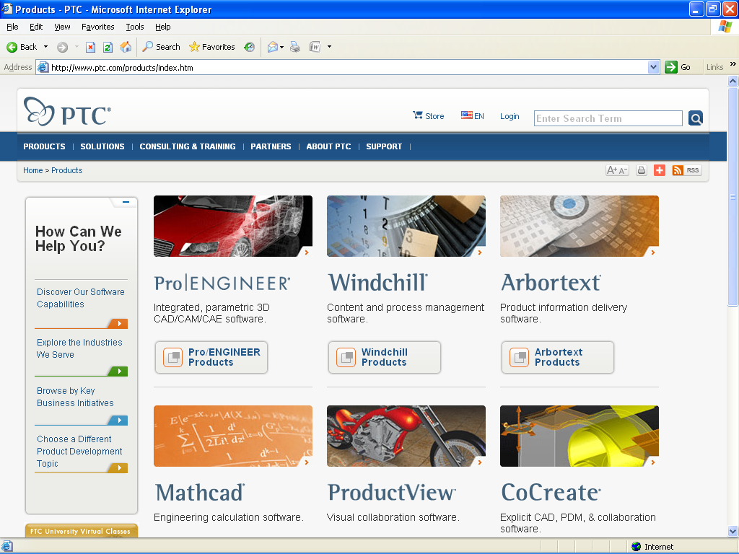


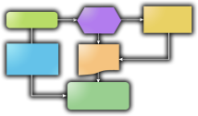



Aras Integrated Solutions
Concept
Design
Development
Launch
Manufacture
Support
Phase-based Program Management
Design
CAD/EDA
Document Mgt
File Vault
CMII Change Mgt
ERP
CAD / EDA
File Management
ERP
Connectors
“The Void”
No Visibility
No Repeatable Processes
Not Lean
Quoting Process
Requirements
&
Specifications
BOMs & Parts
AVL / AML
Qualified
Suppliers
Part
Approval
Reports &
Dashboards
FMEA
Process Flows
Control
Plans
CAPA
Corrective Actions

Slide 8
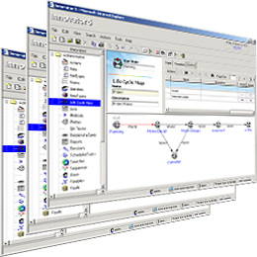



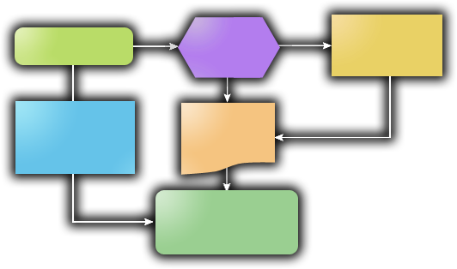


Aras Integrated Solutions
Aras Program Management
Phase-Gate Projects
Milestones & Deliverables
Traffic Light Risk Dashboards
PMI Project Templates
Enterprise Open Source Solutions
Download Includes:
3 Aras Certified Solutions
Program Management
Product Engineering
Quality Planning
Aras Product Engineering
Bill Of Materials [BOM], Product SKUs
File & Document Management
Change Management Workflows
Approved Vendor Lists [AVL/AML]
Aras Quality Planning
Risk Management
Failure Mode Effects Analysis [FMEA]
Control Plans
Action Item Closed-Loop
PLM Community Solutions:
Corrective & Preventive Actions
Training & Skills Tracking
Quality Systems
Tooling Management
Manufacturing Process Planning
Variant Configurator
CAD Integrations
http://www.aras.com/CommunityProjects
Notes:
The Aras Innovator enterprise open source download includes 3 Business Ready Solutions each with comprehensive functionality for…
CLICK 1
At a high-level
Aras Program Mgt includes Phase-Gate Project Mgt with Milestones & Deliverables, Traffic Light Risk Indicators and Dashboards, and project templates based on the PMI pjt mgt principles
The Aras Product Engineering solution includes functionality for managing complex configuration structures such as Bills of Material and Product SKUs
There are Document Management capabilities that can be used for any type of file format including Word Docs, Excel spreadsheets, PDFs, Images like TIFFs, multimedia files, and CAD drawings – I should mention that Aras Innovator is NOT an ‘in-process’ CAD file manager; it doesn’t have CAD integrations, however, it can be used to store CAD files it just doesn’t do parametric data extraction. [pause]
(if asked, “What’s the recommended way for dealing with CAD files” respond, “I don’t know what CAD packages your company uses, but most of them have a local CAD manager or PDM system. They really handle the ‘in-process’ activities well; that’s what they were designed to do. Aras will typically just integrate with that system if a company needs CAD data extraction.”
There are graphical Change Management workflows that can be used to control any of the documents or data in the system
And then there are other features like Approved Vendor / Approved Manufacturer Lists, part classification, substitutes & alternates, and a lot more
The Aras Quality Planning solution is used for Risk Analysis & Management
It’s got Failure Mode & Effects Analysis or FMEAs, both DFMEAs and PFMEAs, and then there are Process Flow Diagrams and Control Plans for mitigating any risks identified
And because Aras is a database driven system everything is tied together so that when you change data or add or delete items all the other related documents stay synchronized
Also, unique to Aras is the concept of Action Items for identified risks or RPNs over a specified threshold; they provide closed-loop issue resolution for accountability and certainty
CLICK 2
Also, because Aras is open source there are a growing number of Community Solutions available such as Corrective & Preventive Actions or CAPA issue management, RoHS environmental compliance, and things like Training & Skills Tracking and Customer Quoting. Projects are going on now around Integration Adapters for ERP systems and alternate clients such as Windows and Outlook access
All of this solution functionality and more is available, however, the Aras solutions are designed so that you can use as little or as much as you need. Functionality can be ‘turned off & on’ with user permissions. Everything is roles-based so users only see what they have permission to see.
In addition, the Aras solutions can be used as a stand-alone system or as an compliment to extend your existing enterprise systems

Slide 9
Agenda
Aras Company Overview
PLM ‘out-of-the-box’ Solutions
Aras Model-Based Technology (configurability)
Enterprise Open Source Business Model
Demo

Slide 10


Aras Technology Platform Model-Based SOA
Conventional Systems
Aras Innovator
Client
Client
Compiled Logic
XML Solution Models
Fundamentally
Different
Server Code
Web Services SOA
Files
Database
Files
Database
Real-Time Flexibility
Graphical Drag & Drop Real-Time Changes Without Complex Programming
Benefits
Guaranteed Upgradeability
Technology Separation Enables Quick & Easy Upgrades Without Impacting Customizations
Notes:
So, I’ve talked about the flexibility of the software… and there’s a reason that Aras solutions are significantly easier to customize than conventional legacy systems.
CLICK 1
It’s because Aras uses a unique and proven innovation that is fundamentally different than other systems. Aras combines a Web services service-oriented architecture with a Model-based approach.
Together the Aras technology delivers Unmatched Flexibility while achieving Unparalleled Upgradeability
Solution forms, workflows, lifecycles, and even the data schema can be changed in real-time with a graphical solution studio editor. The customization and creation of solutions is done at a business level with flow charts and forms not complex programming code.
This is important because it means solution customization can be done by regular people like power uses and business systems analysts instead of expensive consultants and programmers.
Aras has always had these capabilities, and now we’ve made it available as Microsoft Enterprise Open Source…

Slide 11












Aras Technology Platform N-Tier Client Server Architecture, 100% Web and Cloud Enabled
OFFICE
MOBILE
CAD
BROWSER
LEGACY
APPLICATIONS
Web Services Connections
Innovator Framework
“Application Server”
Microsoft .NET
SQL Server
IIS
Database
File Vault

Slide 12
Aras Technology Platform Rapid Development of New Applications
that Leverage Standard Web Services
OFFICE
MOBILE
CAD
BROWSER
LEGACY
APPLICATIONS
Web Services Connections
Versioning
Permissions
Workflow
Lifecycle
Vaulting
Classification
CM
….
Innovator Framework
“Application Server”
100% Web Services
Aras Modeling Engine
Application X
Model
Application Y
Model
Application Z
Model
Database
File Vault

Slide 13
Aras Technology Platform Architectural Stack
Clients
Multiple purpose-built clients
End User Client
Utility
Integration
Client Interface
Open, documented interfaces
Main Service
WSDLs
Solution Meta Model
Logic
Business Logic
Product
Engineering
Powerful business application modeling engine
Quality
Management
Program
Management
Processes
Business Processes
Objects
Business Objects
Core Enterprise Application Services
Access Control
Federation
Search
Lifecycle
Classification
Workflow
Configuration
Versioning
Vault
Small, tightly controlled, secure, highly optimized core
Core Meta Model
Core Objects
Data Interface
Database Interface
Vault Interface
External Interfaces
Neutral data abstraction layer
Raw Data
Database
Flexible metadata and file storage
File Vault

Slide 14






Aras Technology Platform
Enterprise PLM Architecture
Browser
Office Integrations
CAD
Connectors
Business Logic
Outlook
Word
Excel
SharePoint
.NET UI Components
Innovator Object Model
IOM
XML – SOAP Messages
Client Side
.NET Web Services
Open
Standards
Server Side
Business Logic
SOA
XML/SOAP
Business Objects & Processes
Web Services
Meta Data Management
Lifecycle Services
Workflow Services
Configuration Services
Classification Services
Search Services
Event Services
Security Services
Vaulting Services
Federation Services
Data Access Components
.NET Integrations
ADO
ODBC
Flat File
Direct API
O-R Mapping
Transaction Mgt
Cache
ADO.NET Data Access
Business Logic
Business Objects & Processes
Object Definitions
Aras File Vault
Process Definitions
System Definition

Slide 15


Aras Technology Platform Web Architecture
Access from outside the Firewall
http or https
Internet
DMZ
Reverse Web Proxy
Firewall Tunnel
single port communication
Internal Clients
Windows 2003 or 2008 Servers
ERP …
CAD Connectors
CAD
File Vaults
ARAS Innovator Apps & Microsoft IIS
Microsoft SQL Server Database
Share Point Server

Slide 16

Aras Technology Platform Configuration Options
Single Server for Initial Deployment / Small Scope
~ 200 users
Multiple Servers for scalability
~ 2,500 users
Distributed Servers for performance over
the corporate WAN & large scale deployments
Site 3
Innovator Client Cache
Web Server
Site 1
Site 2
Innovator Server
Aras Vault Server
Aras Vault Server
Innovator Server
Aras Vault Server
HQ
SQL Server
SQL Server
Innovator Server
Single Server:
Innovator Server
Vault Server
SQL Server
Multiple Servers:
Innovator Server
Vault Server
SQL Server
Distributed Servers:
Innovator Server(s)
Vault Server(s)
SQL Server

Slide 17




Enterprise Open Source
Microsoft Enterprise Open Source
No Software License Fees
Enterprise Production Ready
No Time-Outs, No User Limits
INCLUDED
Fast Growing PLM Community
Uses Microsoft Platform & Skills
Enterprise Class Support
No PLM License Fees
BENEFITS

Slide 18
Quick Facts… Enterprise Open Source
Switched to Enterprise Open Source in Jan 2007
Use Ms-PL license for OS Projects
OSI certified
No contribution requirement
Freedom to use, modify, redistribute
Aras Innovator is freely available
No License Expenses
Enterprise Production-Ready System
Source code under Community Source license
Aras distributes as enterprise open source, …
We don’t use Open Source

Slide 19
What is Enterprise Open Source?
Enterprise Open Source
Open Source
OSI compliant
No contribution requirement
Open Source Solutions
Flexible
Extendable
Collaborative
Source freely available to Everyone
Community Source
Binary download
Provides corporate security and control
Community Source Framework
Secure, Managed
Source available to Subscribers
Standard Commercial Platforms
Proven, Qualified
Enterprise Open Source combines multiple formats to provide corporations with the confidence and assurance necessary for business-critical solutions while delivering open flexibility for collaborative innovation.
It is ‘by business, for business’.

Slide 20
Aras EOS Quick Facts
The enterprise solutions from Aras are open source; source is freely available to everyone, can be modified, redistributed and is governed by OSI certified licenses.
Anyone using Aras has control over their own data model, schema, business rules, definition of forms, workflows, lifecycles, etc.
The SOA framework from Aras is freely available. It is community source; source code is available to a defined ‘community’; in our case paid Subscribers. This ensures a managed, stable, predictable and secure approach which is designed to provide corporate IT groups with complete confidence while still giving them control to do whatever they need.
We refer to ourselves as ‘enterprise open source’ – a combination of formats that provide global enterprises with both flexibility and control.

Slide 21







What is Enterprise Open Source?
Enterprise Open Source
Open Source Solutions
Flexible
Extendable
Collaborative
Source freely available to Everyone
Community Source Framework
Secure, Managed
Source available to Subscribers
Standard Commercial Platforms
Proven, Qualified

Slide 22
Business Model
How Aras Makes Money
Subscription Model, Similar to Red Hat (NYSE: RHT)
Predictable Recurring Revenues from multi-year Contracts
Profitable, Scalable, Proven
Customer Benefits
Subscriptions Are Completely Optional
Eliminates Up-front Investment in Software Licenses
Predictable Annual Fixed Costs
Reduced / Balanced Risk

Slide 23

What Subscriptions Include
– Much More Than Maintenance –
Subscription Packages Include a number of benefits that are important for a business-critical enterprise software system
Monthly Service Packs
Security Updates, Hot Fixes
New Features & Capabilities
Microsoft Certified Version
Subscriber-only Solutions
Live Hotline and Online Support with Unlimited Incidents
Training class attendance included
System Upgrade Services included
► No other enterprise software provider includes Upgrades… Only Aras!
Slide 23

Slide 24
How to get Started
Download & Install Aras Innovator
Education
Aras Web site www.aras.com
Aras Forums www.aras.com/forums
Workshops
Training classes
Plan the Implementation Roadmap and Architecture
Use the local PLM implementation local experts
Phased Rollouts highly recommended
Decide “Replace” or “Complement and Extend” for the existing systems

Slide 25
Questions ?
Notes:
25

Slide 26
Software Demo
Aras Innovator Easy-to-Learn
User Experience
User Interface
Solutions Easy-to-Use
Product Lifecycle Management
Enterprise Quality Management
Program Management
Administration Easy-to-Change
Item changes
Form changes
Process changes
Notes:
26

Slide 27
Deployment Methodology
Download & Install
Discovery Workshop
[ Pilot ]
Support Subscription
Core Team Training
Phased Rollout
Customize
Integrate
Data Migration
End-User Training
[ Repeat ]
$0 {no license fees}
$15k
[ $6k – $50k ]
$60k - $350k
$15k
$100k - $400k

Slide 28
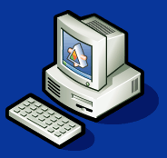







Model-Based SOA Framework Platform Requirements
Low-Cost Infrastructure
All Microsoft
Enterprise Scalability
Browser
Optional Components
Active Directory
SharePoint
Exchange / Outlook
Reporting Services

Slide 29
Model-Based SOA Framework Configuration Options
Single Server for Initial Deployment / Small Scope
~ 200 users
Multiple Servers for scalability
~ 500 users
Distributed Servers for performance over
the corporate WAN and large scale
deployments.
Site 3
Innovator Client Cache
Web Server
Site 1
Site 2
Innovator Server
Aras Vault Server
Aras Vault Server
Innovator Server
Aras Vault Server
HQ
SQL Server
SQL Server
Innovator Server
Single Server:
Innovator Server
Vault Server
SQL Server
Multiple Servers:
Innovator Server
Vault Server
SQL Server
Distributed Servers:
Innovator Server(s)
Vault Server(s)
SQL Server

Slide 30
Customer Resources
IT Infrastructure
Installation and distributed server performance planning
DB and Vault backup / restores
.NET security policies
Administration
User account creation & Access Rights management
End User Training
Help Desk / Issue tracking
Analyst
Requirements and specifications
Business process consulting
Modeling of Forms, Workflows, Lifecycles, Permissions
App Dev
Create Items, Forms, & Workflows and custom business logic
Reports and Dashboards
Interfaces, Integrations, Federation

Slide 31
Aras Training Classes
PLM, QP and PM (1 day each)
Understanding and using the standard business-ready solutions
Also see: on-line help and the tutorials on the Aras website
Administration (2 days)
Understanding Innovator concepts and servers
Using the Solutions Studio to build and modify items, forms, lists, permissions, sequences, …
Workflow (1 day)
How to design and implement Workflow process automation
Email, Lifecycle and Business Rules integration
API – Advanced Developer (2 days)
Method writing (server and client extensions & business rules)
Integration techniques (SOAP, XML, API’s)

Slide 32
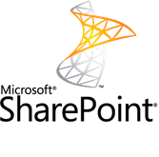
SharePoint Overview
​SharePoint is a business collaboration and content management platform that enables formal and informal business communication, within the enterprise and beyond
Great for team sites, simple document management, workflows and collaboration
Widely included in enterprise license agreements (even if you don’t currently use it, you may already have licenses)

Slide 33
SharePoint and PLM
​Many attempts have been made to implement full PLM within SharePoint
In general, SharePoint does informal processes well, but formal/structured processes are more difficult:
Document Management with revision control
Bills of Material, costing, sourcing
Configuration Management and Engineering Change
Phase/Gate project management

Slide 34
Aras and SharePoint
​SharePoint is not required to use Aras, but we have options for those who would like to use both
The Aras SharePoint Connector is available today
Search, View, Upload/Download SharePoint Documents from inside Aras Innovator
On-going collaborative development efforts with Microsoft will integrate more PLM data in SharePoint
Eventual goal is to enable SharePoint users to use all PLM features

Slide 35


SharePoint Options
SharePoint
Portal
Aras
Browser-Based Client
SharePoint
Services
Managed Solutions
Community Solutions
Product Engineering
Demo
Program Management
PLMe
ITIL
Quality Planning
…
Aras Model-Based SOA Framework
Aras Vault Server
SharePoint
Vault

Slide 36
SharePoint Option 1
SharePoint
Portal
Aras
Browser-Based Client
SharePoint
Services
Managed Solutions
Community Solutions
Product Engineering
Demo
Program Management
PLMe
ITIL
Quality Planning
…
Aras Model-Based SOA Framework
Aras Vault Server
SharePoint
Vault

Slide 37
SharePoint Option 2
SharePoint
Portal
Aras
Browser-Based Client
SharePoint
Services
Managed Solutions
Community Solutions
Product Engineering
Demo
Program Management
PLMe
ITIL
Quality Planning
…
Aras Model-Based SOA Framework
Aras Vault Server
SharePoint
Vault

Slide 38
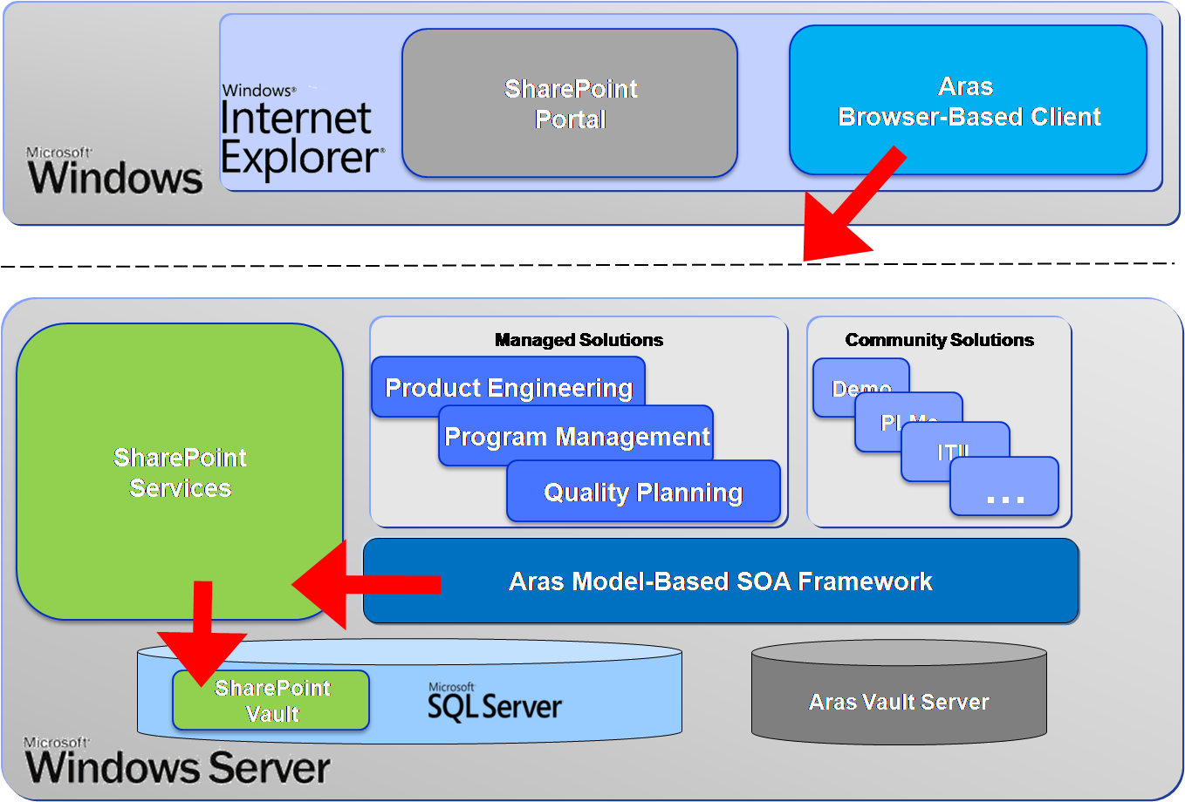
SharePoint Option 1 Details
SharePoint Documents exposed in Aras Innovator
Available today inside Aras standard solution

Slide 39
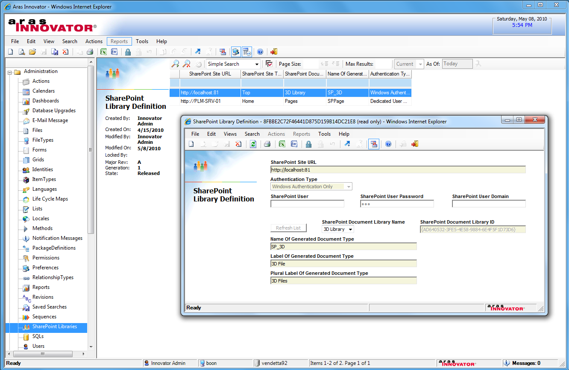
SharePoint Library Definition

Slide 40
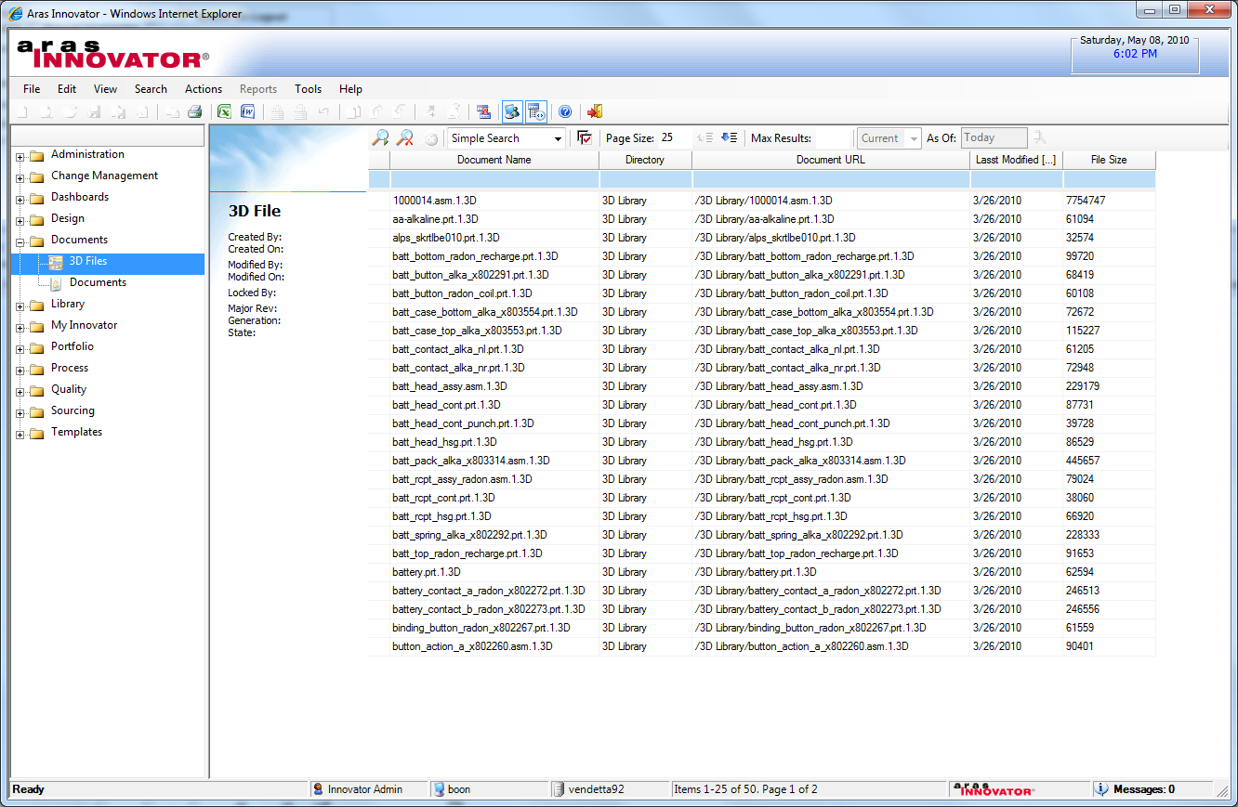
SharePoint Documents

Slide 41
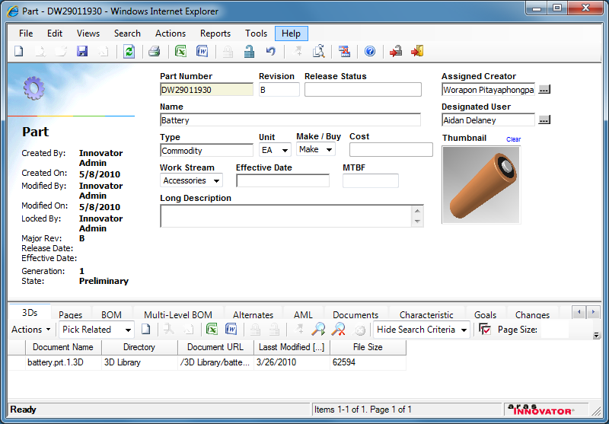
SharePoint Attachments

Slide 42
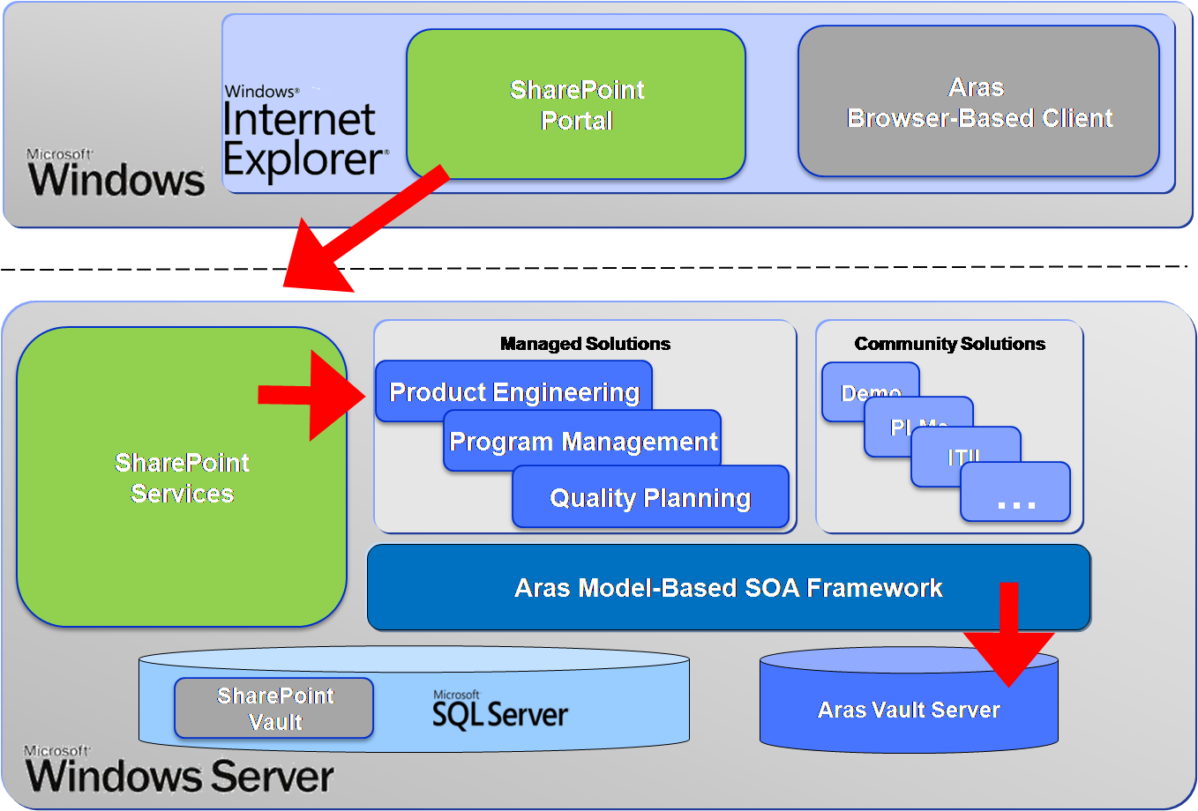
SharePoint Option 2 Details
Aras items exposed in SharePoint
Co-development with Microsoft & Actify
Available today from CodePlex.com

Slide 43
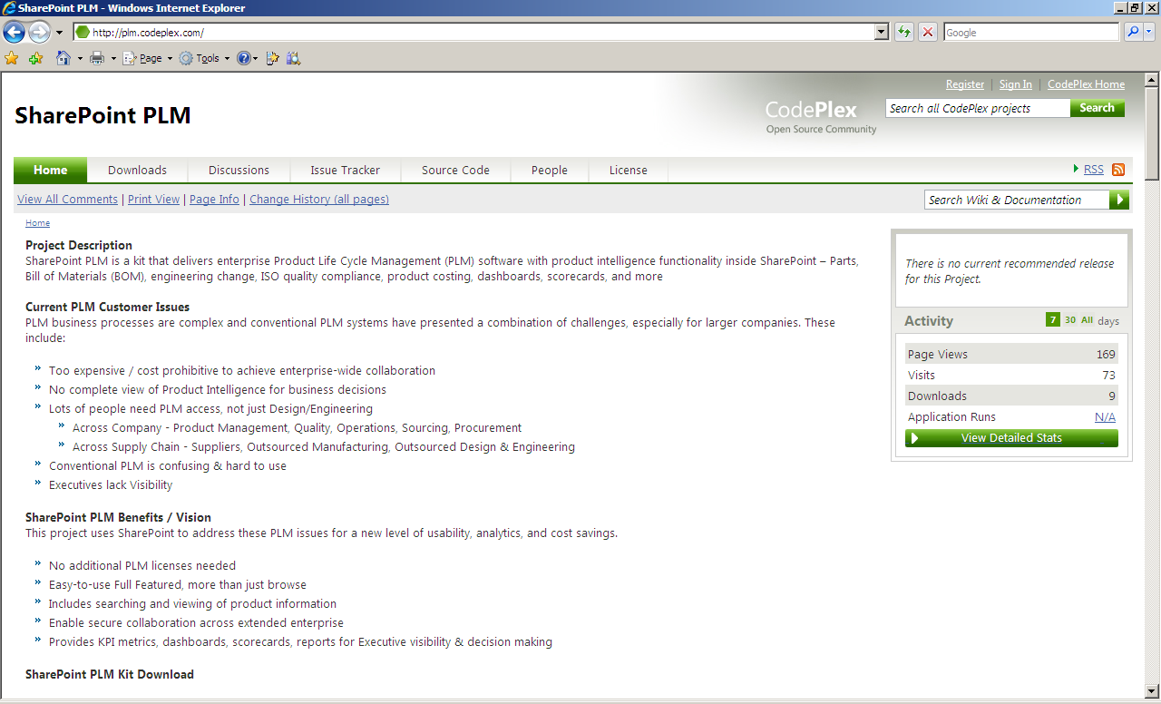
Codeplex Project

Slide 44
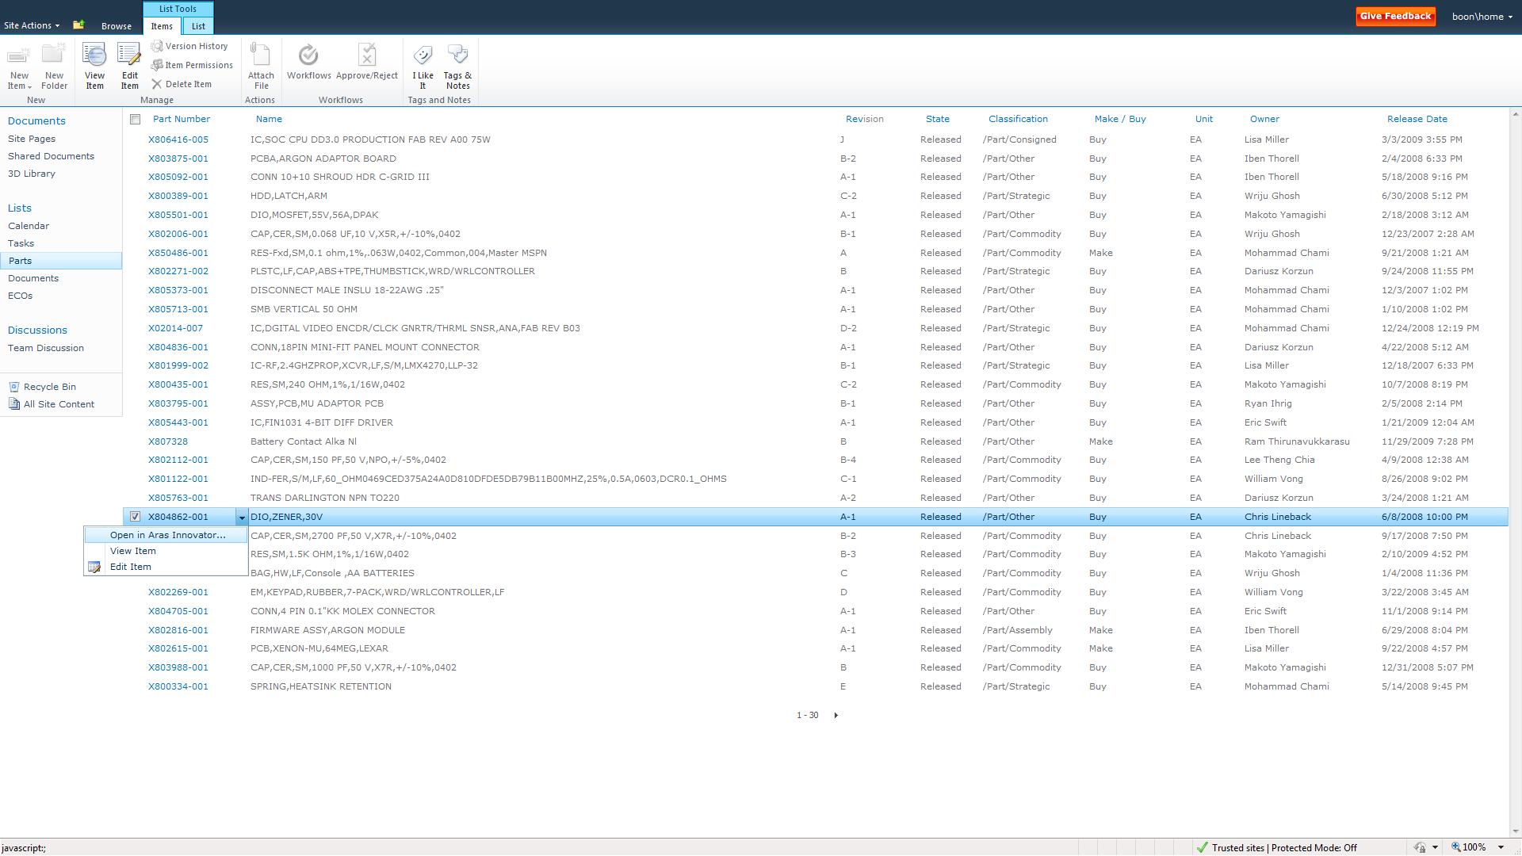
Part Grid
Configurable TOC
And Grid Columns
Open Items in Aras Innovator
Live Data Directly from Aras Innovator

Slide 45
Software Demo
Aras Innovator Easy-to-Learn
User Experience
User Interface
Solutions Easy-to-Use
Product Lifecycle Management
Enterprise Quality Management
Program Management
Administration Easy-to-Change
Item changes
Form changes
Process changes
Notes:
45

Slide 46
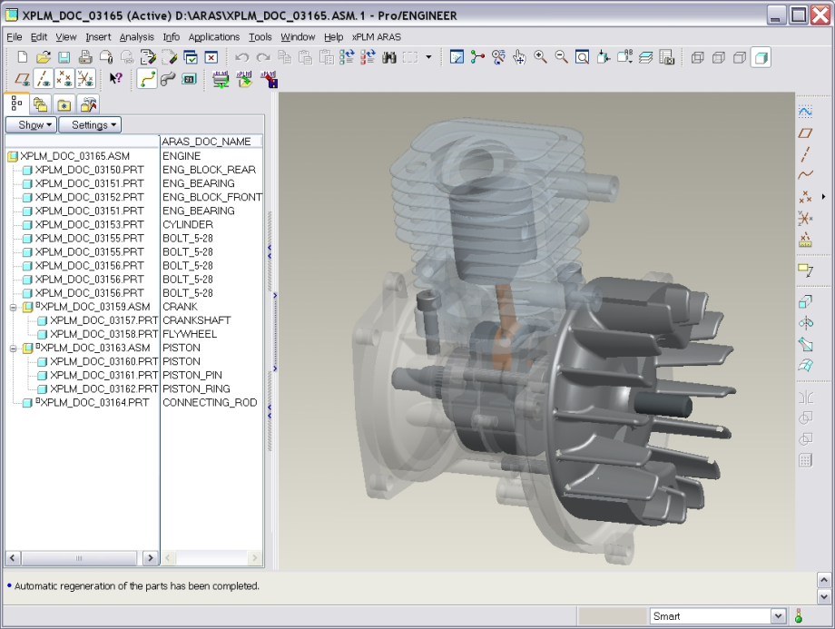
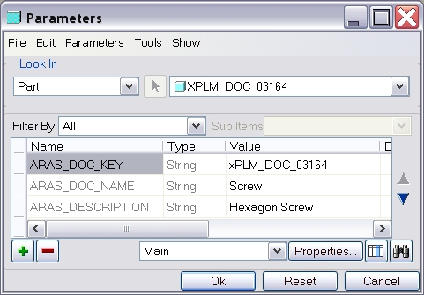
Pro/Engineer - Innovator Integration
Document & File Management
Management of Complex CAD Structures, including generics
Support of all relevant CAD objects
Create and Update of Material Master & BOM
Workflow and Release Management
Check-in and Check-out from CAD
Automatic Rename to Unique File Names
Take and Release Ownership
Management of Multiple Revisions
Save Preview Before Final Saving
Search and Load from Pro/E or PLM
Bidirectional Exchange of Properties
Update PLM-Attributes from CAD
File Conversion (e.g. Viewables)

Slide 47

SolidWorks - Innovator Integration
Document & File Management
Management of Complex CAD Structures and configuration
Support of all relevant CAD objects
Create and Update of Material Master & BOM
Workflow and Release Management
Check-in and Check-out from CAD
Automatic Rename to Unique File Names
Take and Release Ownership
Management of Multiple Revisions
Save Preview Before Final Saving
Search and Load from SolidWorks or PLM
Bidirectional Exchange of Properties
Update PLM-Attributes from CAD
File Conversion (e.g. Viewables)

Slide 48
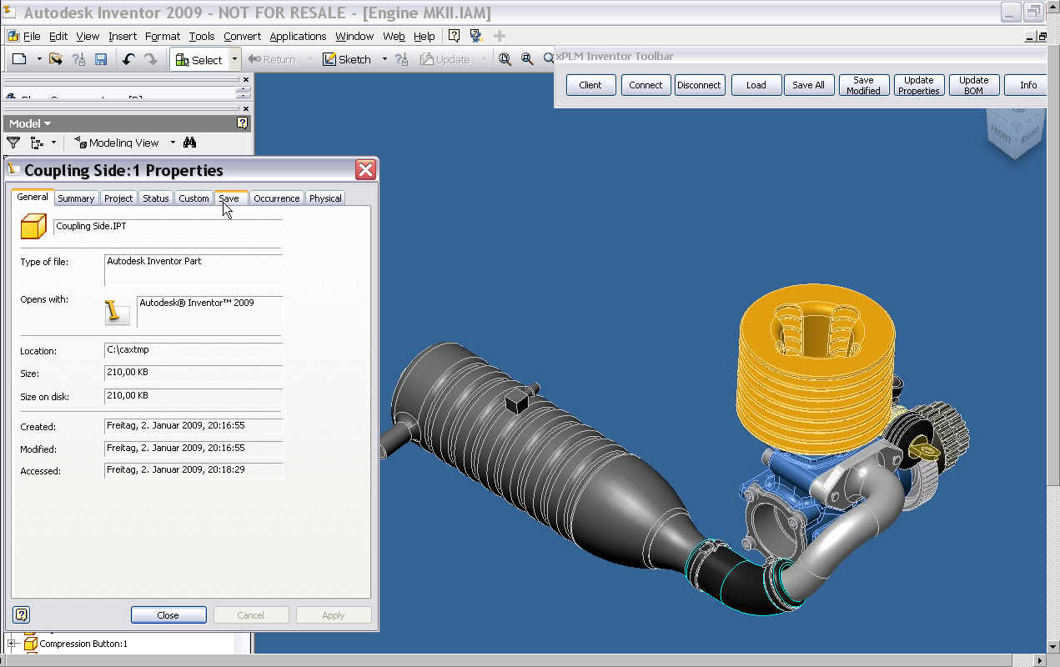
Autodesk Inventor - Innovator Integration
Document & File Management
Management of Complex CAD Structures
Support of all relevant CAD objects
Create and Update of Material Master & BOM
Workflow and Release Management
Check-in and Check-out from CAD
Automatic Rename to Unique File Names
Take and Release Ownership
Management of Multiple Revisions
Save Preview Before Final Saving
Search and Load from Inventor or PLM
Bidirectional Exchange of Properties
Update PLM-Attributes from CAD
File Conversion (e.g. Viewables)

Slide 49
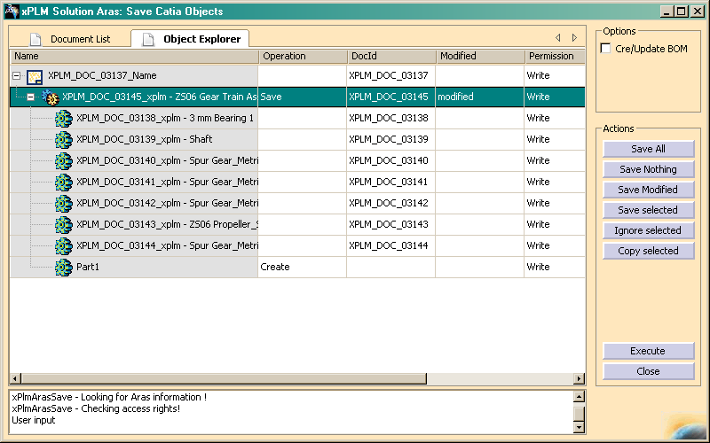
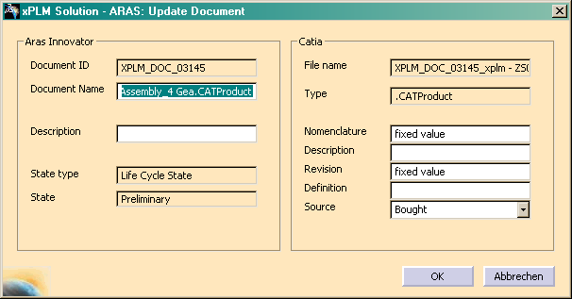
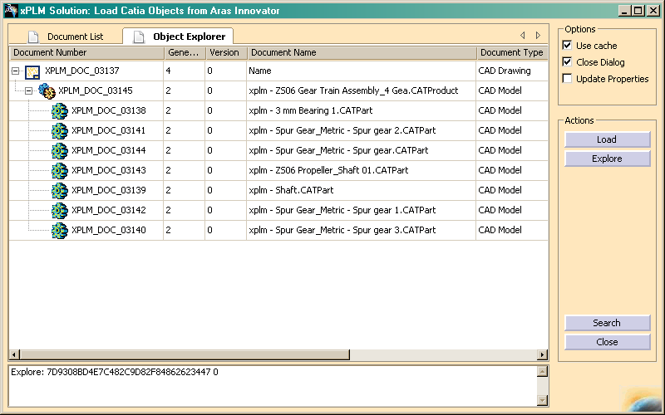
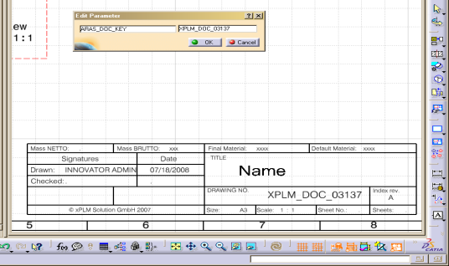
Catia - Innovator Integration
Document & File Management
Management of Complex CAD Structures
Support of all relevant CAD objects
Create and Update of Material Master & BOM
Workflow and Release Management
Check-in and Check-out from CAD
Automatic Rename to Unique File Names
Take and Release Ownership
Management of Multiple Revisions
Save Preview Before Final Saving
Search and Load from Catia or PLM
Bidirectional Exchange of Properties
Update PLM-Attributes from CAD
File Conversion (e.g. Viewables)

Slide 50
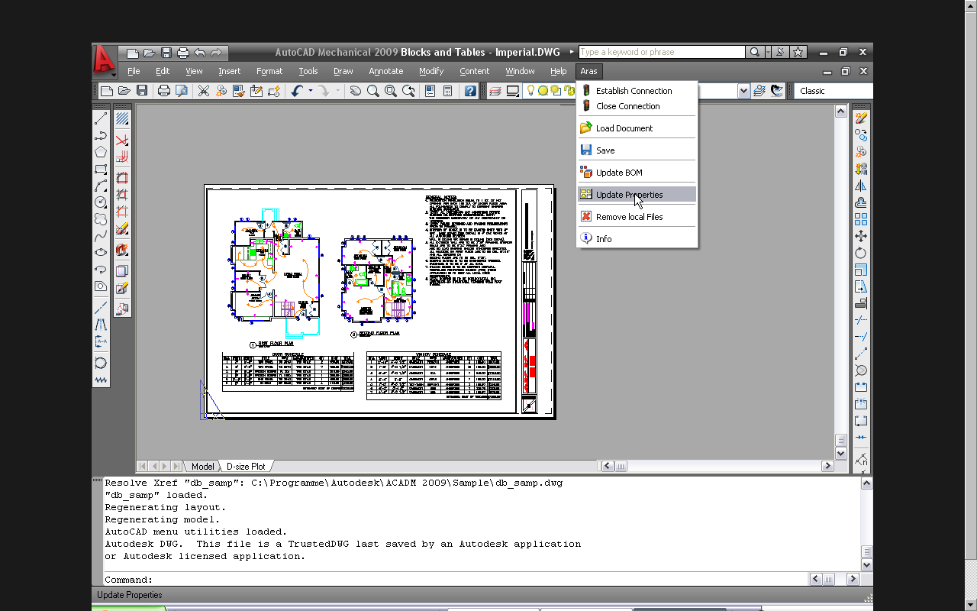
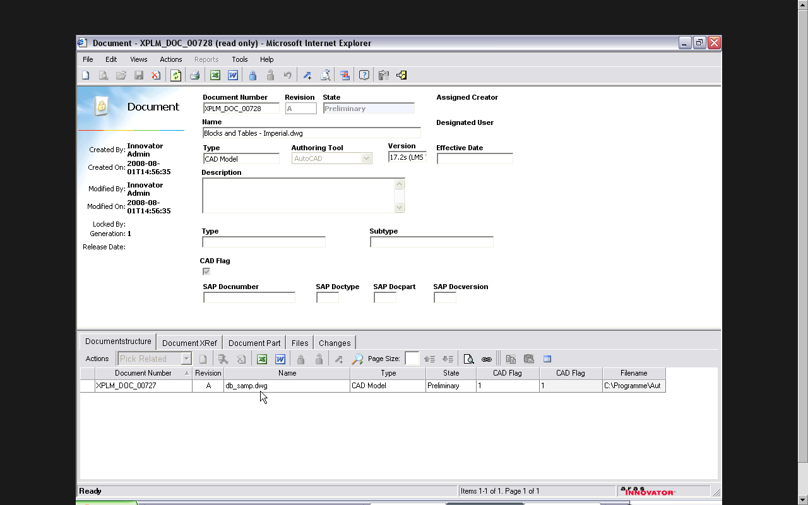
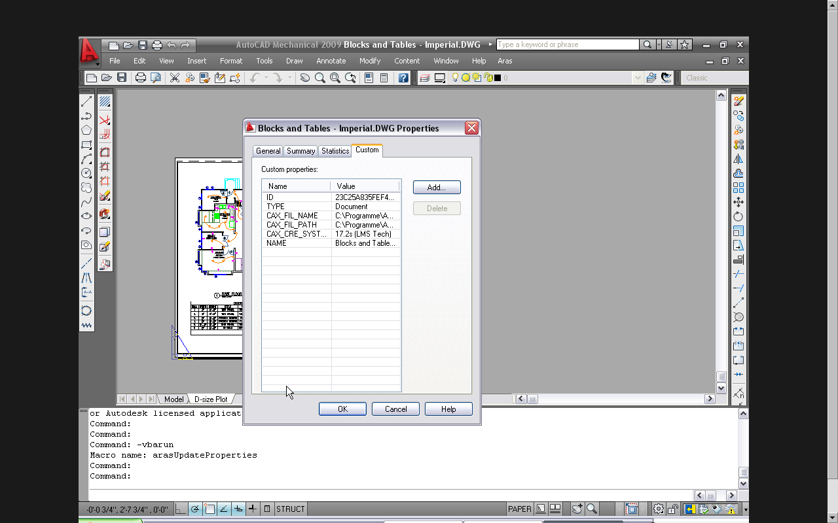
AutoCAD - Innovator Integration
Integrated in the Innovator User Interface
Load and save of CAD document structures including external references
Update of Documents, Material Masters and BoM
Customizable user interface
Workflow and Process integration
Conversion and Transfer of Viewables
Bi-directional update of object properties

Slide 51
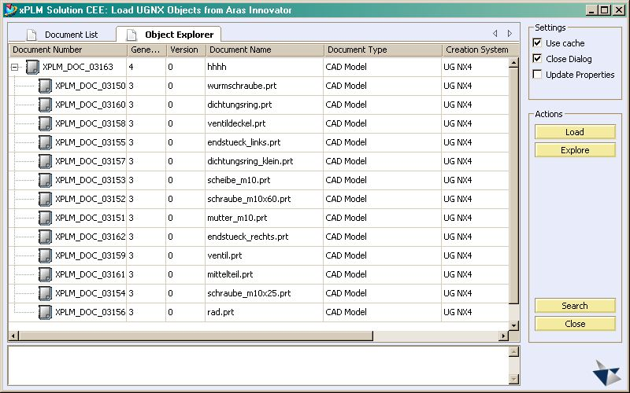
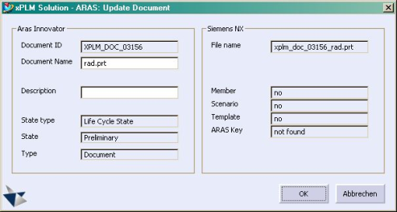
NX - Innovator Integration
Document & File Management
Management of Complex CAD Structures
Support of all relevant CAD objects
Create and Update of Material Master & BOM
Workflow and Release Management
Check-in and Check-out from CAD
Automatic Rename to Unique File Names
Take and Release Ownership
Management of Multiple Revisions
Save Preview Before Final Saving
Search and Load from NX or PLM
Bidirectional Exchange of Properties
Update PLM-Attributes from CAD
File Conversion (e.g. Viewables)

Slide 52

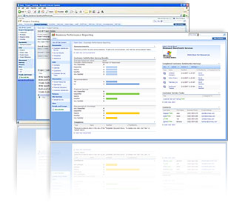

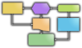


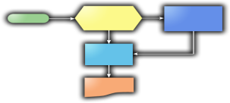
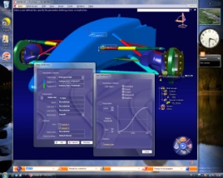
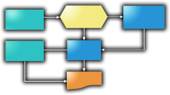

Integration / Rollout Strategy
Integrate To and Extend Existing PDM
Use Aras Web Services to Provide Full Featured Enterprise PLM Corporate-wide
Enterprise Open Source
Replace Existing PDM When Ready to Realize Even Greater Savings
Aras Model-Based PLM
SOA Approach
Full PLM Functionality
Windchill
IntraLink
eMatrix
CDM/VPM
Teamcenter
IMAN
Business Unit
Business Unit
Business Unit
Business Unit

Slide 53
Catia - Innovator Integration
Document & File Management
Management of Complex CAD Structures
Support of all relevant CAD objects
Create and Update of Material Master & BOM
Workflow and Release Management
Check-in and Check-out from CAD
Automatic Rename to Unique File Names
Take and Release Ownership
Management of Multiple Revisions
Save Preview Before Final Saving
Search and Load from Catia or PLM
Bidirectional Exchange of Properties
Update PLM-Attributes from CAD
File Conversion (e.g. Viewables)

Slide 54
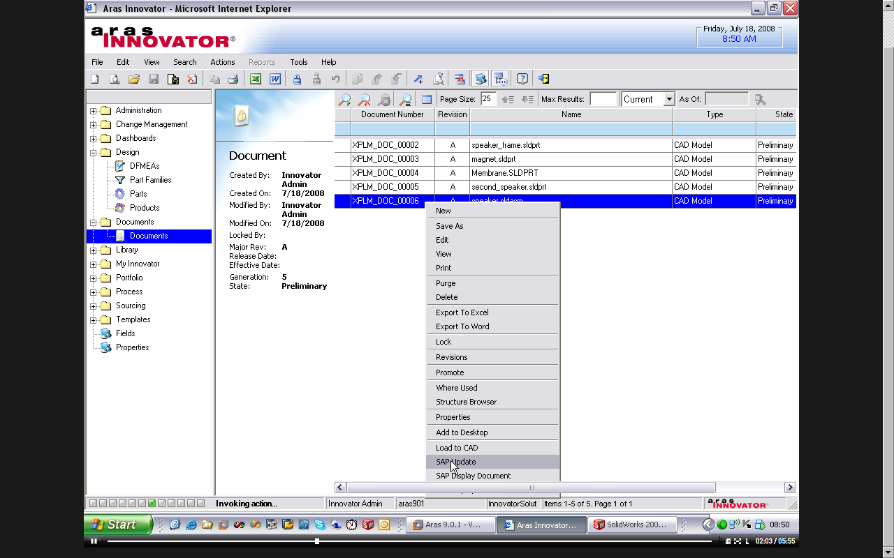
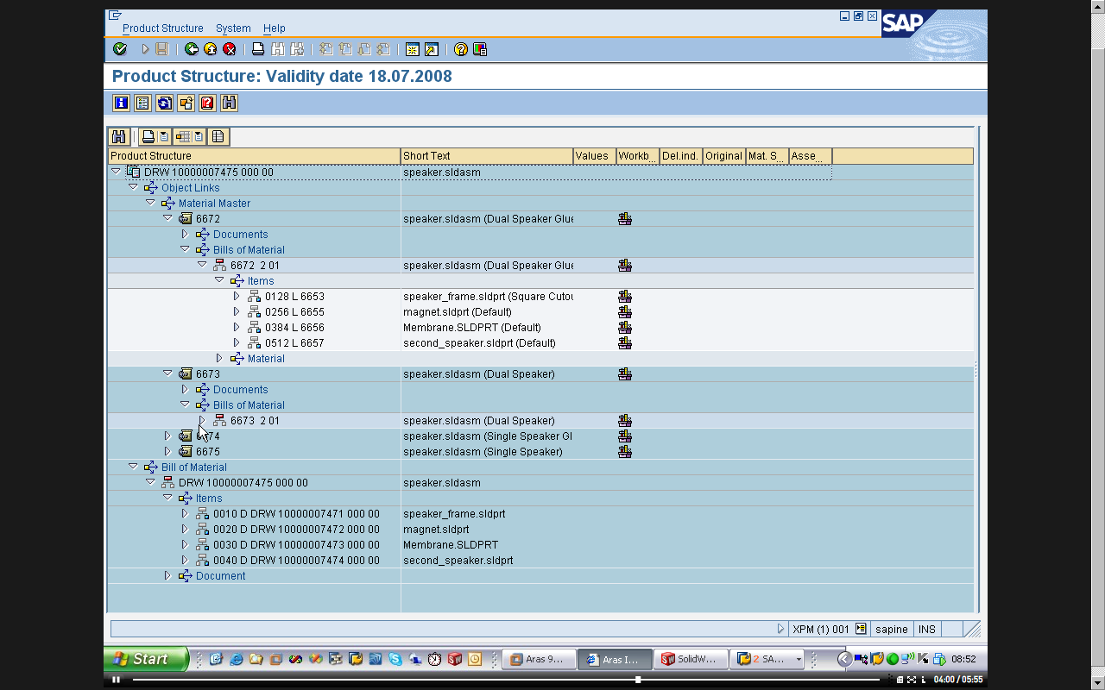

SAP - Innovator Integration
Integrated in the Innovator User Interface
Update of Documents, Material Masters and BoM
Workflow and Process integration
Conversion and Transfer of Viewables
Bi-directional update of object properties
Customizing and Configuration Opportunities

